Slide 1

Agenda:- Cloud Computing
Reyan Nazir
24-SET-053
Information Technology Skill
Submitted to: Umar Hayyat

Slide 2

Definition:-
Cloud Computing is a model of delivering computing services over the internet, where resources such as servers, storage, databases, software, and applications are provided as a service to users on-demand.

Slide 3

Key Characteristics:-
1. On-demand self-service: Users can provision and manage computing resources without requiring human intervention. 2. Broad network access: Resources are accessible over the internet, or a private network, from any device, anywhere in the world. 3. Resource pooling: Resources are pooled together to provide a multi-tenant environment, where resources can be dynamically allocated and re-allocated. 4. Rapid elasticity: Resources can be quickly scaled up or down to match changing business needs. 5. Measured service: Users only pay for the resources they use, rather than having to purchase and maintain their own hardware and software.

Slide 4
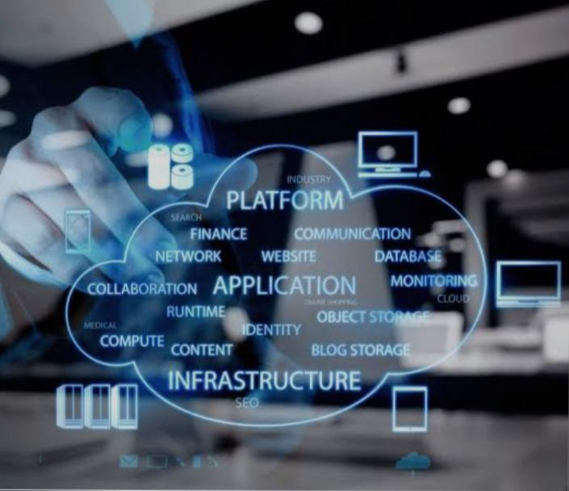
Cloud Service Models:-
1. Infrastructure as a Service (IaaS): Provides virtualized computing resources, such as servers, storage, and networking. 2. Platform as a Service (PaaS): Provides a complete platform for developing, running, and managing applications, including tools, libraries, and infrastructure. 3. Software as a Service (SaaS): Provides software applications over the internet, eliminating the need for users to install, configure, and maintain software on their own devices.

Slide 5
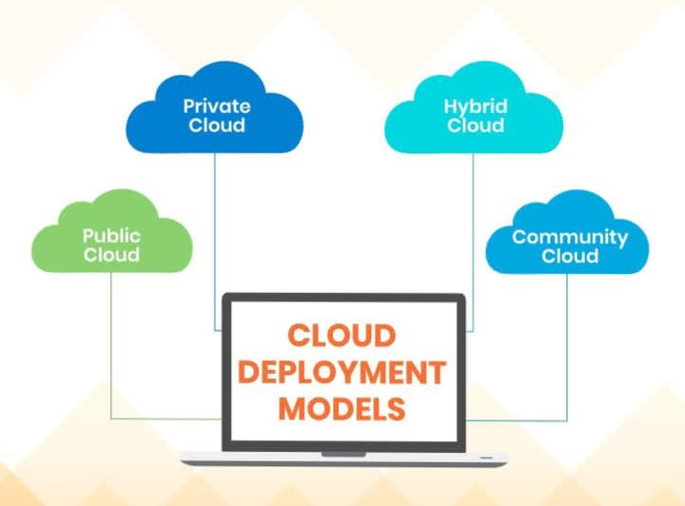
Cloud Deployment Models:
1. Public Cloud: A cloud environment that is open to the general public and is owned by a third-party provider. 2. Private Cloud: A cloud environment that is provisioned and managed within an organization’s premises, typically for the organization’s own use. 3. Hybrid Cloud: A cloud environment that combines public and private cloud services, allowing data and applications to be shared between them. 4. Community Cloud: A cloud environment that is shared by multiple organizations with similar interests or goals.

Slide 6

Cloud Computing Architecture
1. Front-end: The user interface and client-side logic. 2. Back-end: The server-side logic, database, and storage. 3.Network: The communication infrastructure between the front-end and back-end.

Slide 7

Cloud Computing Security:-
1.Data encryption: Protecting data in transit and at rest. 2.Access control: Controlling who can access cloud resources. 3.Authentication: Verifying the identity of users and devices. 4.Compliance: Ensuring cloud services meet regulatory requirements.

Slide 8

Cloud Computing Trends:-
1. Server less computing: Running applications without managing servers. 2.Artificial intelligence (AI) and machine learning (ML): Using cloud-based AI and ML services. 3.Edge computing: Processing data closer to the source. 4.Cloud-native applications: Designing applications specifically for the cloud.

Slide 9
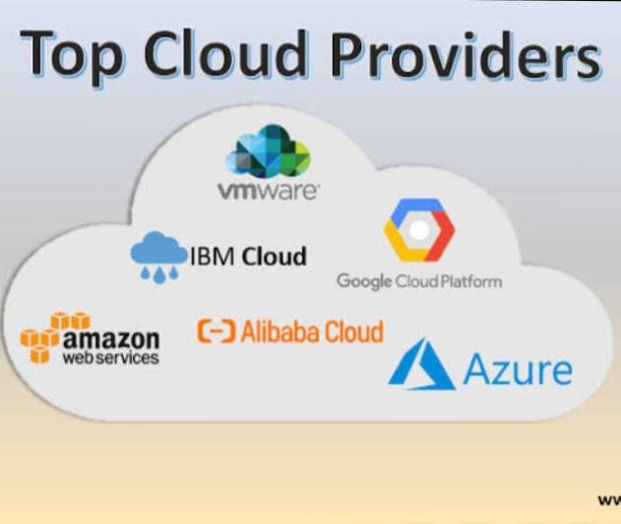
Cloud Computing Providers
1.Amazon Web Services (AWS): A comprehensive cloud platform. 2.Microsoft Azure: A cloud platform for building, deploying, and managing applications. 3.Google Cloud Platform (GCP): A cloud platform for building, deploying, and managing applications. 4.IBM Cloud: A cloud platform for building, deploying, and managing applications.

Slide 10

Benefits:-
1. Scalability: Cloud computing resources can be quickly scaled up or down to match changing business needs. 2. Cost-effectiveness: Cloud computing eliminates the need for upfront capital expenditures on hardware and software. 3. Increased agility: Cloud computing enables businesses to quickly deploy new applications and services. 4. Improved reliability: Cloud computing providers typically offer high levels of redundancy and failover capabilities, ensuring high uptime and availability.

Slide 11

Challenges:-
1. Security: Cloud computing introduces new security risks, such as data breaches and unauthorized access. 2. Compliance: Cloud computing raises compliance issues, such as ensuring that data is stored and processed in accordance with relevant laws and regulations. 3. Vendor lock-in: Cloud computing can make it difficult for businesses to switch providers, due to the complexity and cost of migrating data and applications. 4. Dependence on internet connectivity: Cloud computing requires a reliable internet connection, which can be a challenge in areas with poor connectivity.

